Slide 1


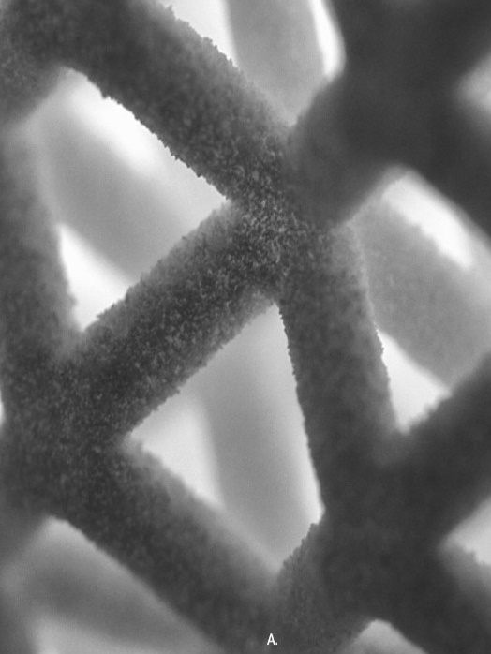
Volumetric extension specification v0.8
with functional representation
2024
copyright by the 3MF Consortium 2024

Slide 2
Volumetric Extension
Volumetric Extension based on 3d Textures

Slide 3
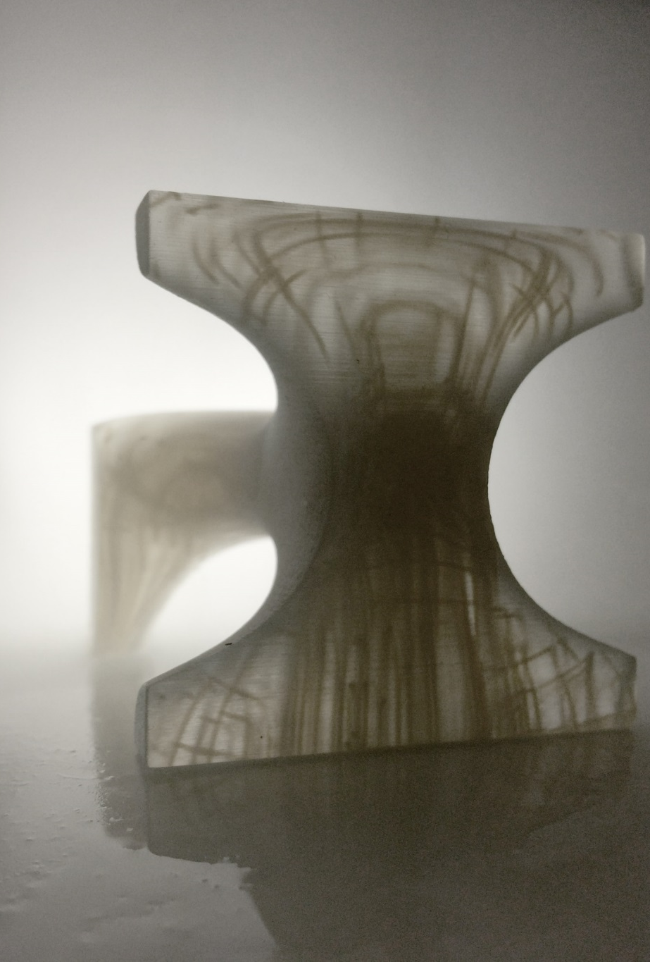
Volumetric extension - Overall concept
Enrich geometry of 3MF with volumetric elements that can represent spatially varying properties
Inefficient to handle with a mesh representation, especially in cases where the variation is continuous in space. => Use a 3D Texture-based or field-based representation. => Encode complex objects by explicitly specifying their properties at any point in space => Provide minimal set volumetric modelling operations

Slide 4
Changes since 2022/01/20
ImageStack is now specialization of Image3D
Sampling channels from image3D now returns a normalize value in the [0-1]-range

Slide 5
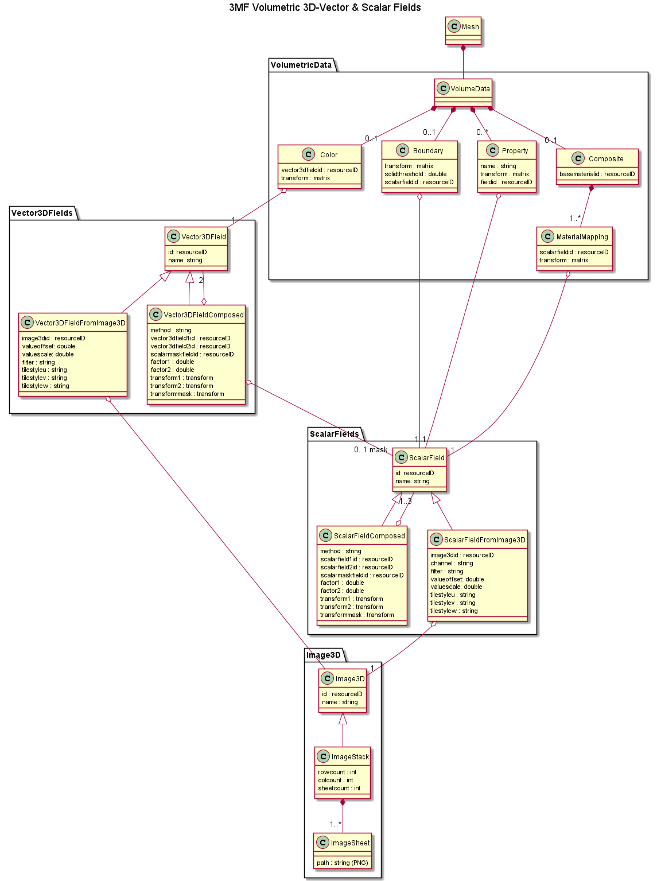
The specification
Volumedata element on Mesh
Scalar Fields
Scalar Field from Image Stack
Composed Scalar Fields
3D Vector-valued Fields
Scalar Field from Image Stack
Composed Vector3D Fields
Voxel data (source)
Image Stack

Slide 6
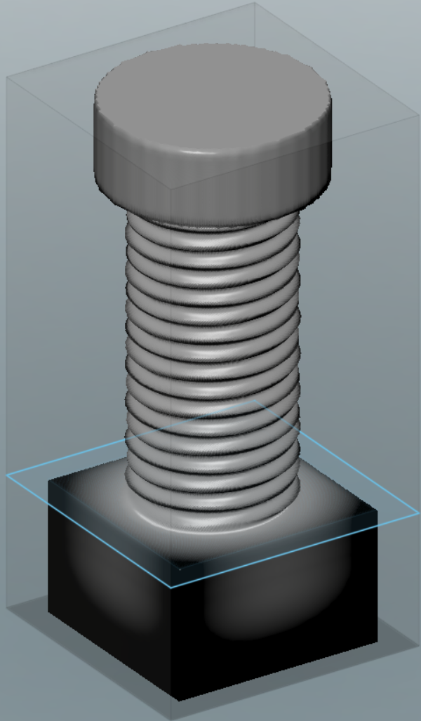
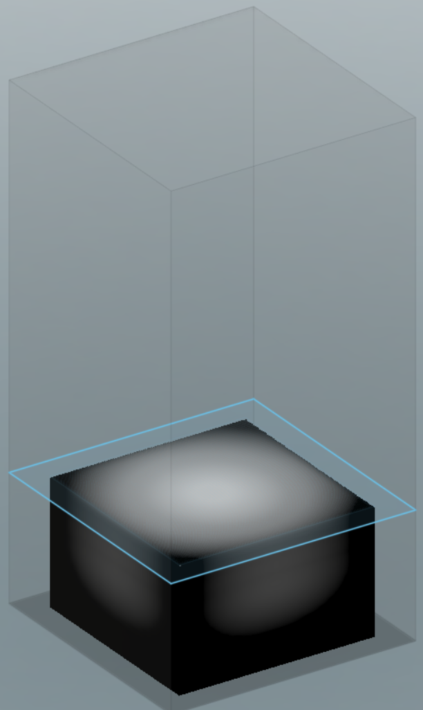
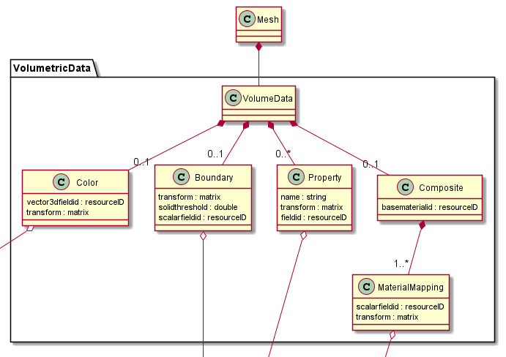
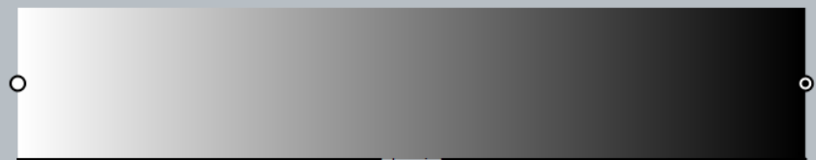
Which information should we encode
Volumetric Data
Encodes complex objects by specifying their properties at any point in space
1. Object boundary (levelset) a single scalar value at each point in space. - If value > threshold => material - If value <= threshold, void
-1
0
1

Slide 7
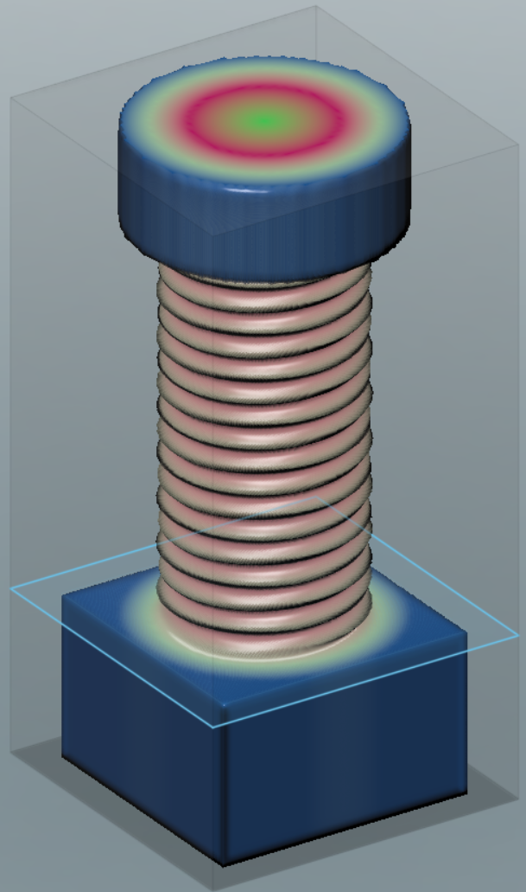
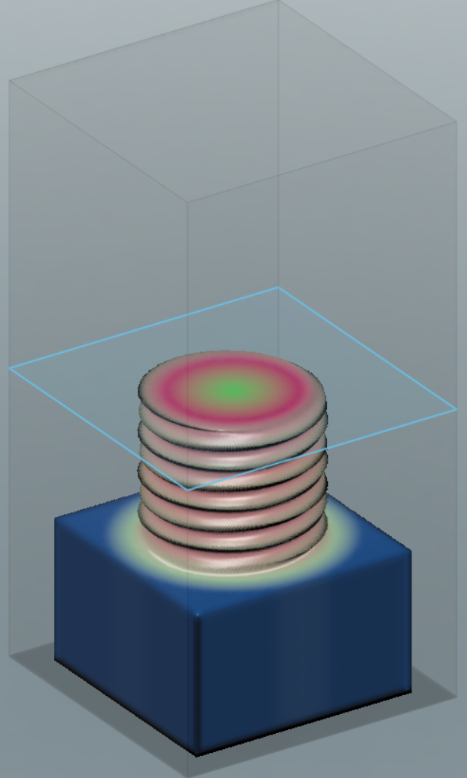
Which information should we encode
Volumetric Data
Encodes complex objects by specifying their properties at any point in space
2. Spatially varying Color A triplet of color values (R, G, B) between 0 and 1 at each point in space

Slide 8
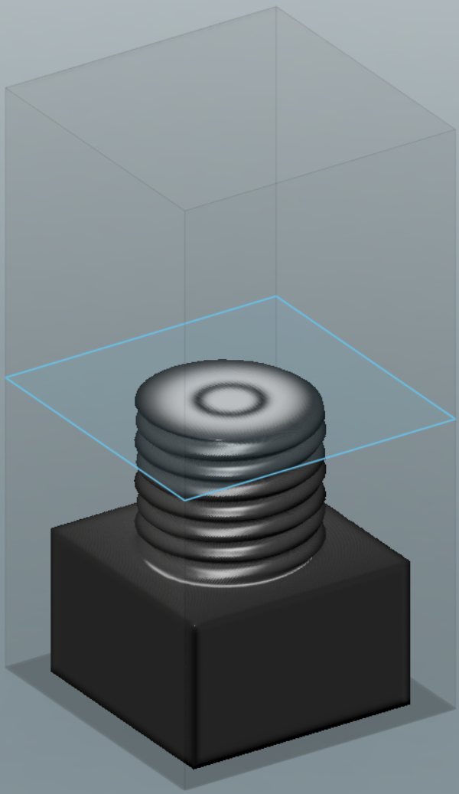
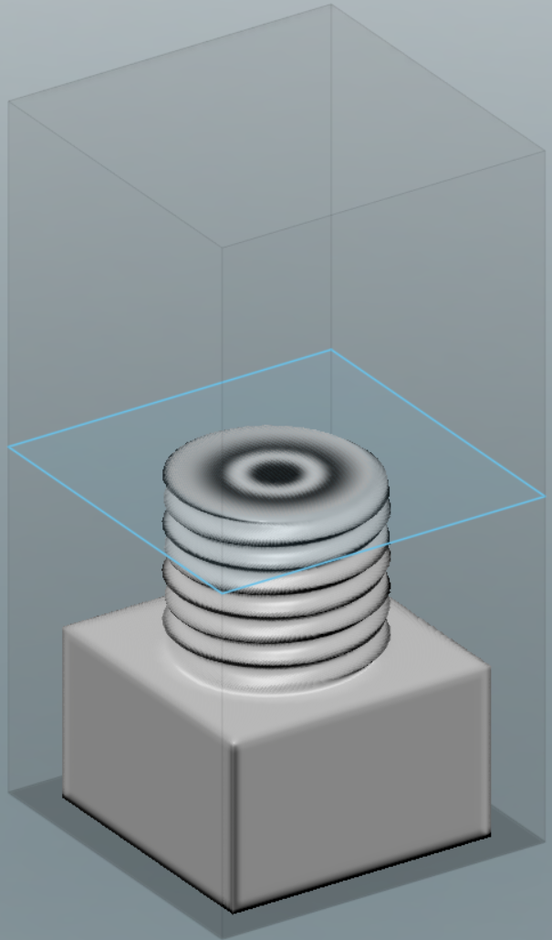
Which information should we encode
Volumetric Data
Encodes complex objects by specifying their properties at any point in space
3. Material composition: - multiple scalar channels with intensities between [0,1] - each associated with a basematerial - mixing according to their intensity
Contribution “Material 1”
Contribution “Material 2”
0
0.5
1

Slide 9
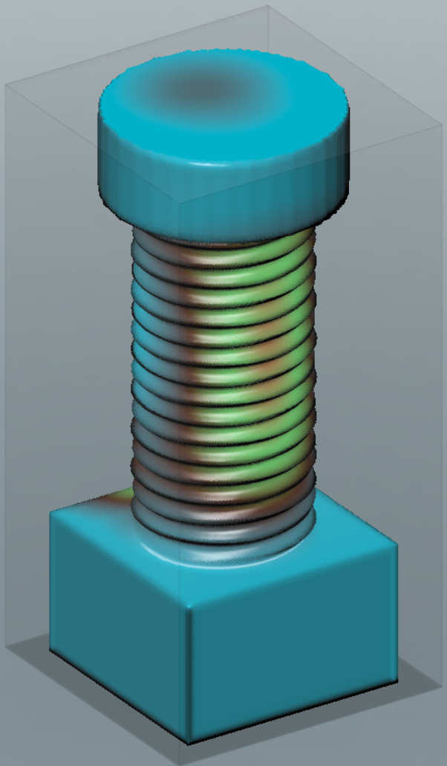
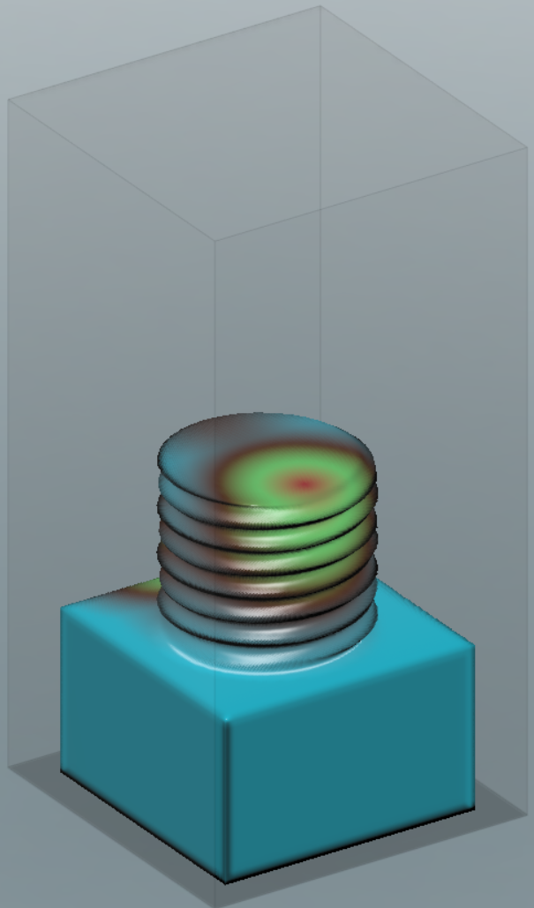
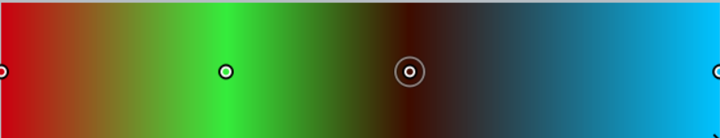
Which information should we encode
Volumetric Data
Encodes complex objects by specifying their properties at any point in space
4. High level (arbitrary) properties: - Single channel with scalar intensity/value - Encode intensity of an abstract property: (“conductivity”, “density”, “durometer”, …) - Consumer can decide, how they mix materials to achieve that property
0
0.5
1

Slide 10
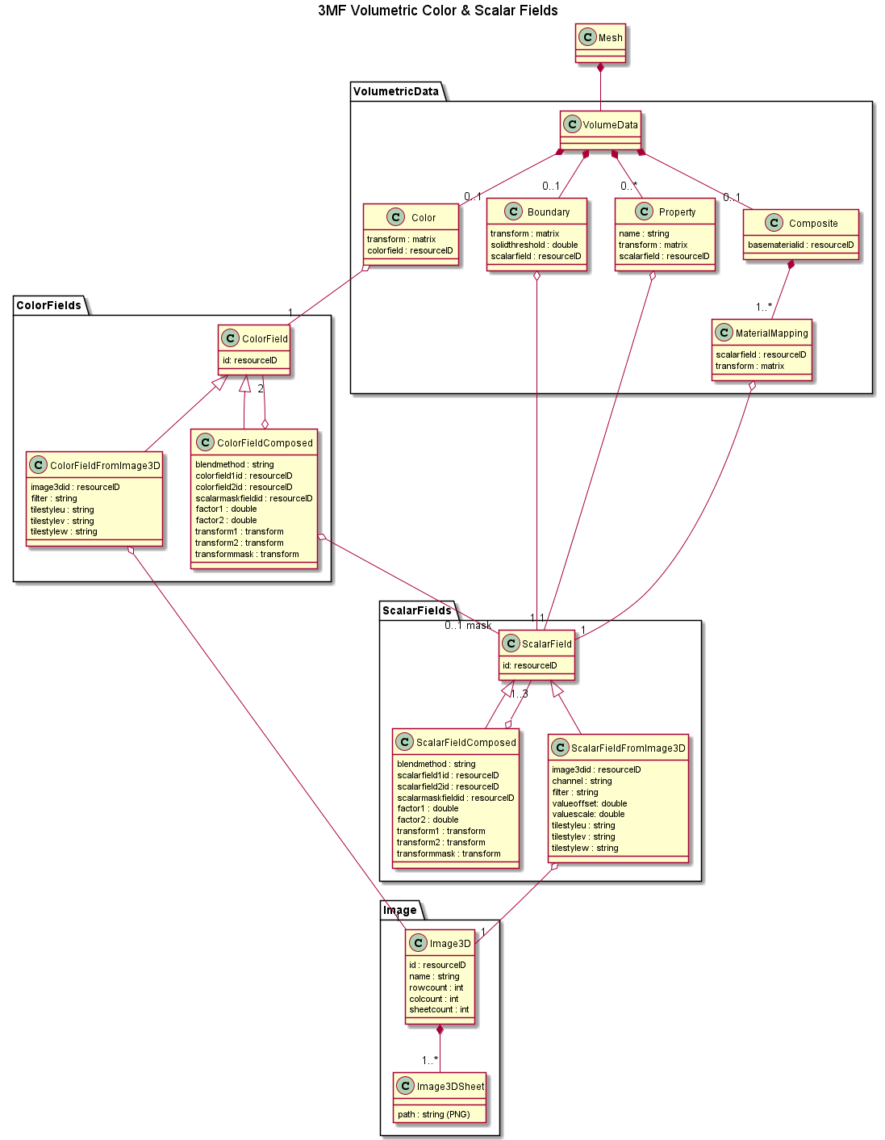
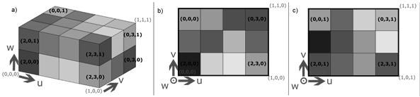
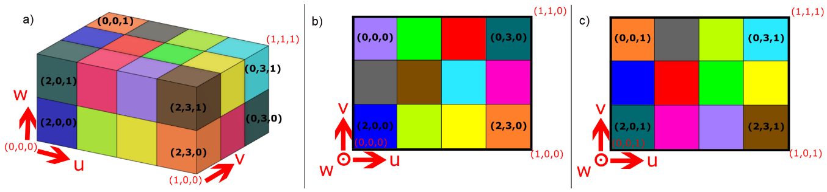
Voxel Grid
implemented as a stack of PNG files
greyscale
or RGB

Slide 11
Voxel Grid
implemented as a stack of PNG files
Grey Alpha
or RGBA

Slide 12
Scalar Fields
f: R^3->R
A mathematical function that assigns every point in space one numerical value.
Two specializations.
ScalarFieldFromImage3D
ScalarFieldComposed

Slide 13
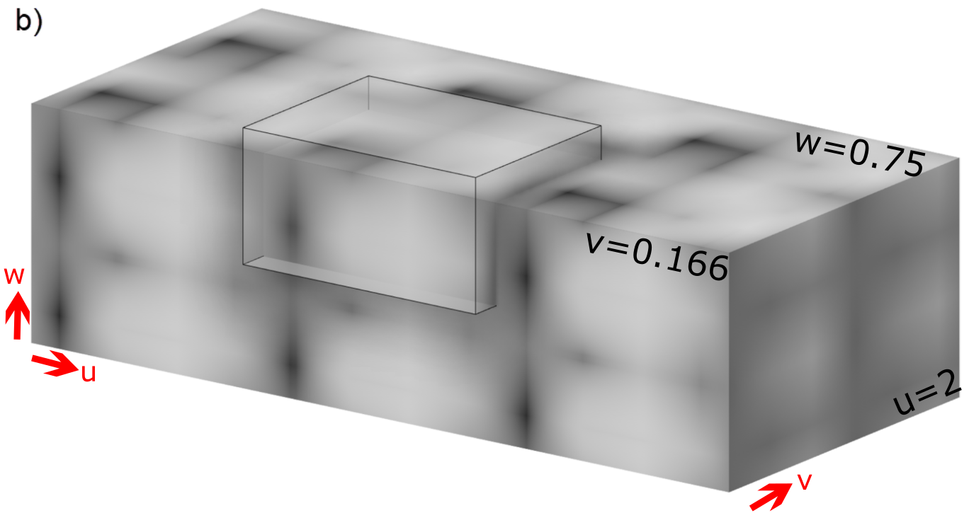
Scalar Field From Image 3D
Allows us to evaluate a channel from the voxelgrid in 3D-space
-10
0
10

Slide 14
Composed Scalar Field
Compose fields from other fields
i.e. apply simple volumetric modelling operations
method ϵ {min, max, multiply, weightedsum, mask}
This gets rid of the stack concept!

Slide 15
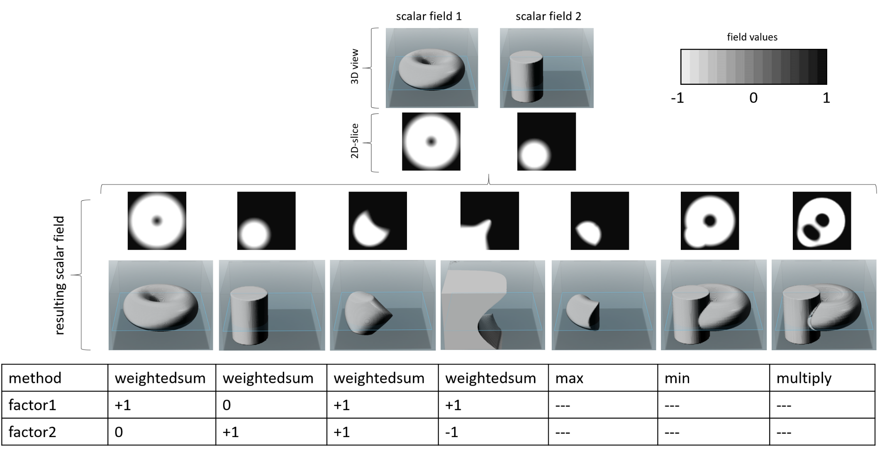
Blendmethods (scalar composition)

Slide 16
3D Vector-Valued Fields
f: R^3->R^3
A mathematical function that assigns every point in a 3D Vector (in particular an RGB-value).
Two specializations.
Vector3DFieldFromImageStack
Vector3DFieldComposed

Slide 17
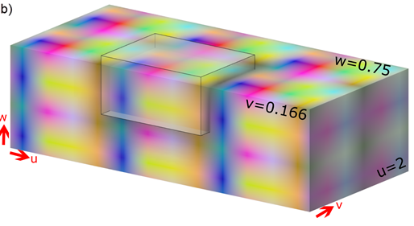
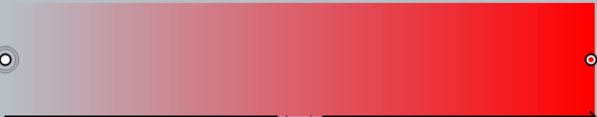
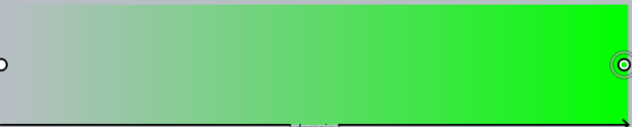
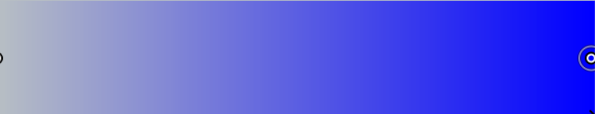
ColorFieldFromImageStack
Allows us to evaluate the RGB voxelgrid in 3D-space
0
1
0
1
0
1

Slide 18
Composed 3D Vector Valued Field
Compose fields from other fields
i.e. apply simple volumetric modelling operations
method ϵ {min, max, weightedsum, multiply, mask}
Like composed Scalar Field, only mask is slightly different.

Slide 19
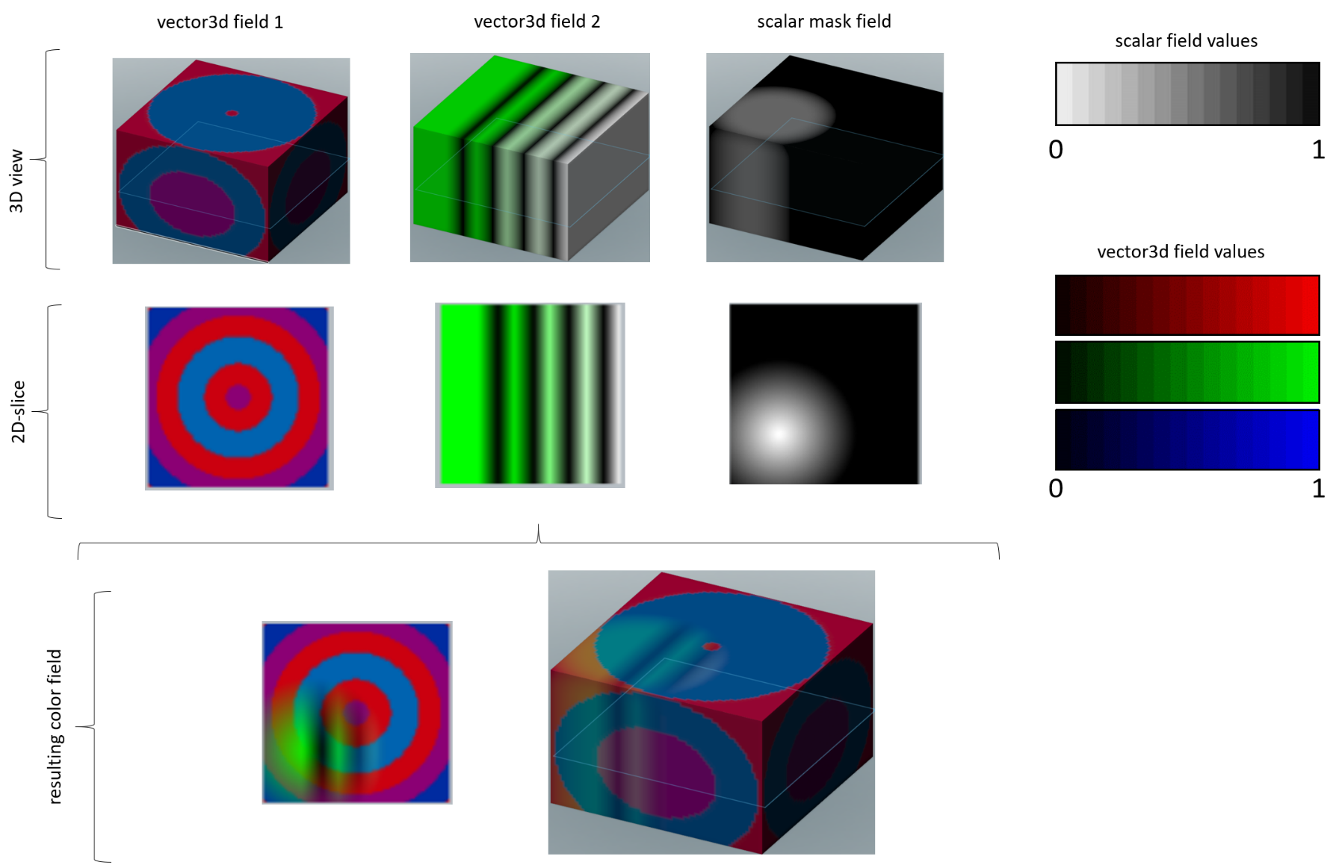
Blendmethod: color mask

Slide 20
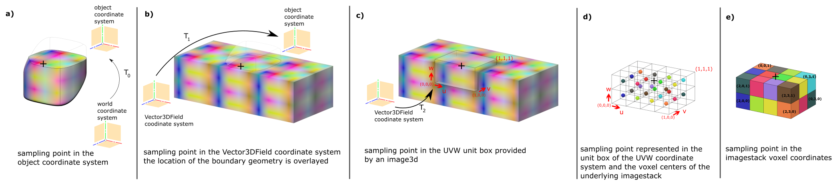
Putting it all together

Slide 21
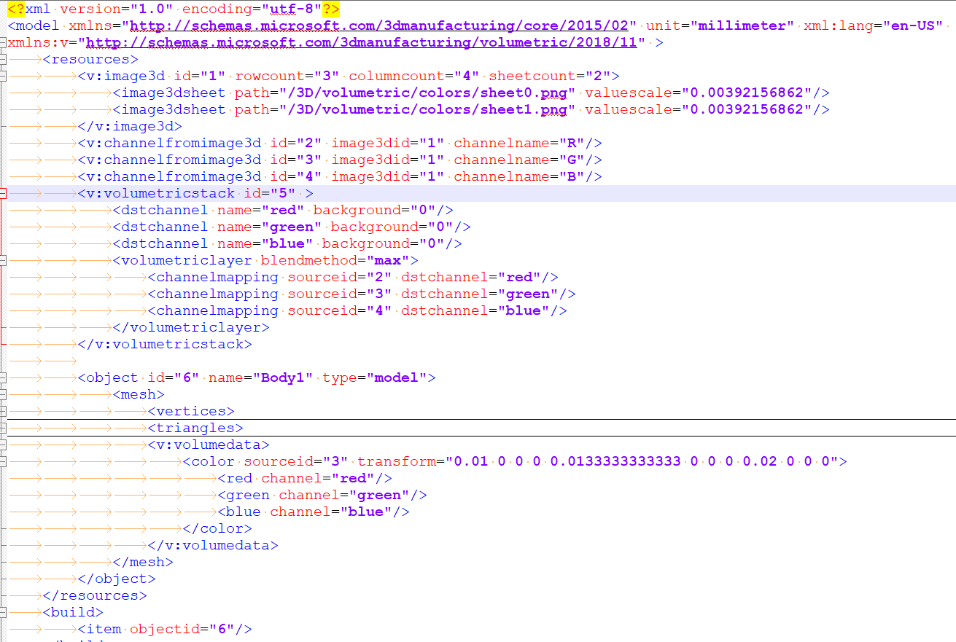
Examples: Color old

Slide 22
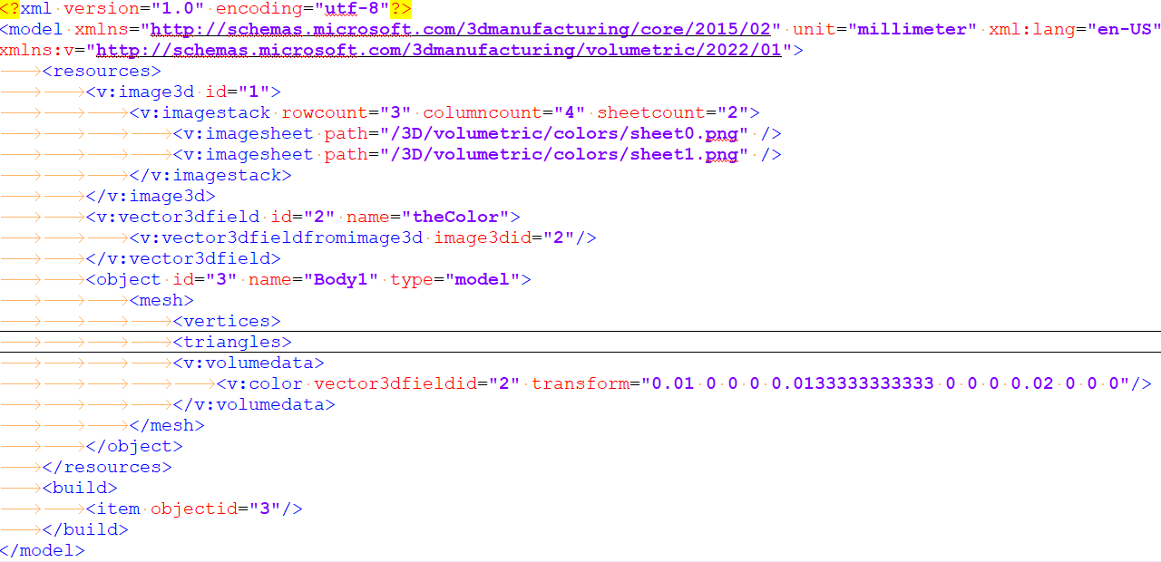
Examples: Color new

Slide 23
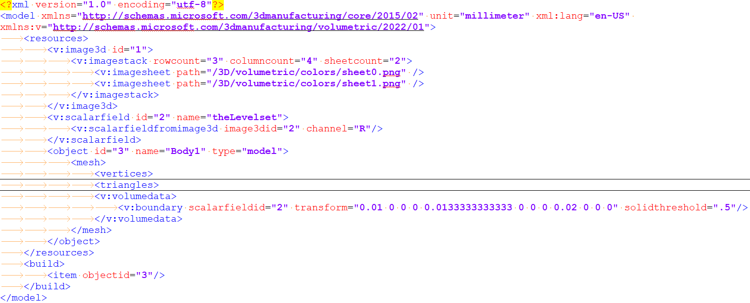
Examples: Boundary new

